Slide 1
Go to www.hockey.ie and click on the Membership tab.

Slide 2
Click on the province you are in and it will bring you to the registration page for that province.
International Overseas Players form is for the International players who live overseas and are not registered with a club in Ireland.
IHUA Umpires and International TO is for IHUA Registered Umpires and International Technical Officials

Slide 3
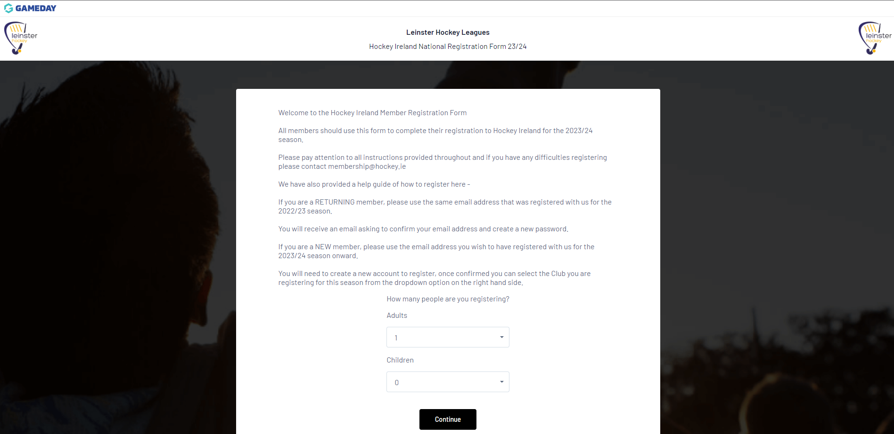
Here you will choose how many members you will be registering. In this case we are just registering one adult player.

Slide 4
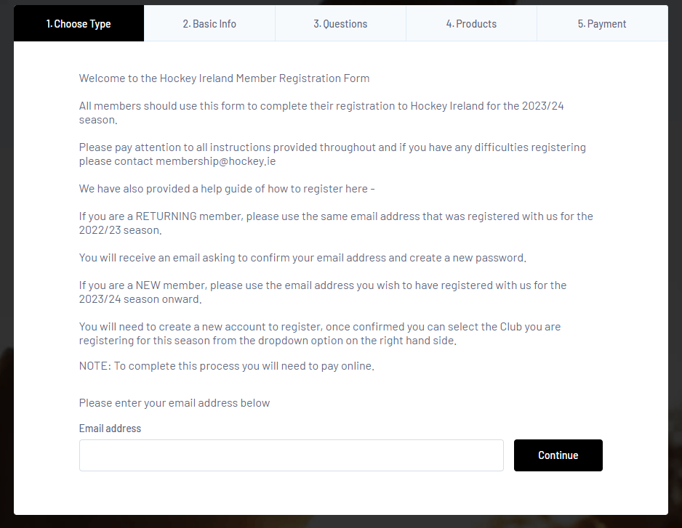
Here, you sign in with the email address you used last season to register. If you forgot it, please email membership@hockey.ie to find out.

Slide 5
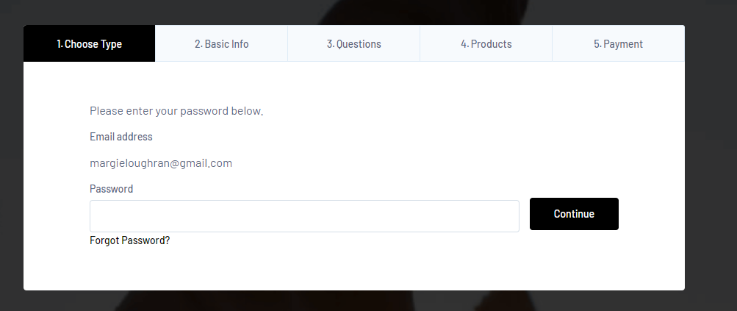
Here, you insert your password. If you forgot it, click on Forgot Password and you will receive an email to reset it. Check your spam folder also as sometimes it goes there. If you don’t receive an email, please email membership@hockey.ie

Slide 6
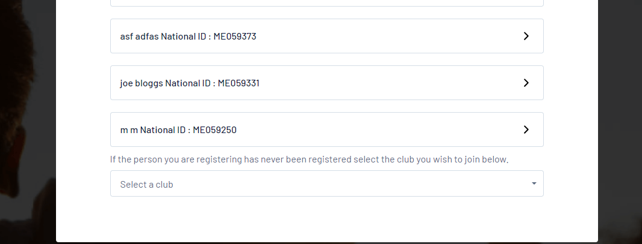
The next page will bring you to the list of members associated with your email address. Click on the ME number for the member you are registering.
Do not click on Select a Club as you will get an orange box error.

Slide 7
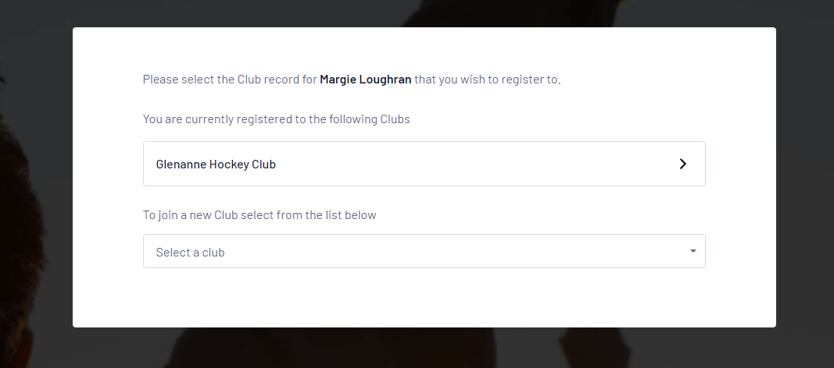
Here, you will see the club you were registered with last season. Click on the Club NOT Select a Club. This will give you a orange error if you do.
Even if you are moving to another club, you need to register with the club you were registered with last season first. Once your province has approved the transfer, you need to do a transfer on GameDay.

Slide 8
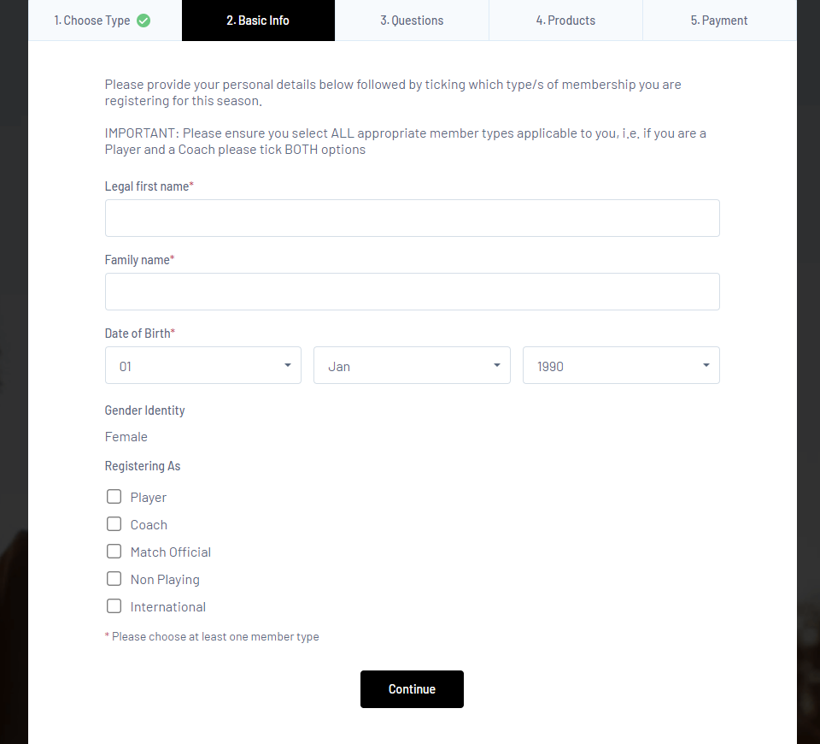
On this page, fill out your name, dob and tick what you are registering as.
Player if you are a player
Coach if you are an EY or Div 2 coach or club volunteer/coach and Non playing is usually a parent or volunteer.

Slide 9
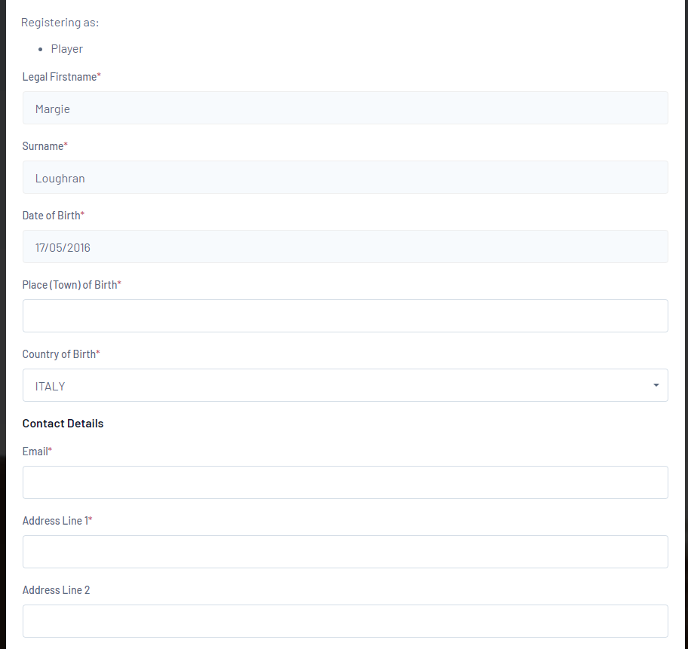
On the next page, fill out all the information with an asterix.

Slide 10
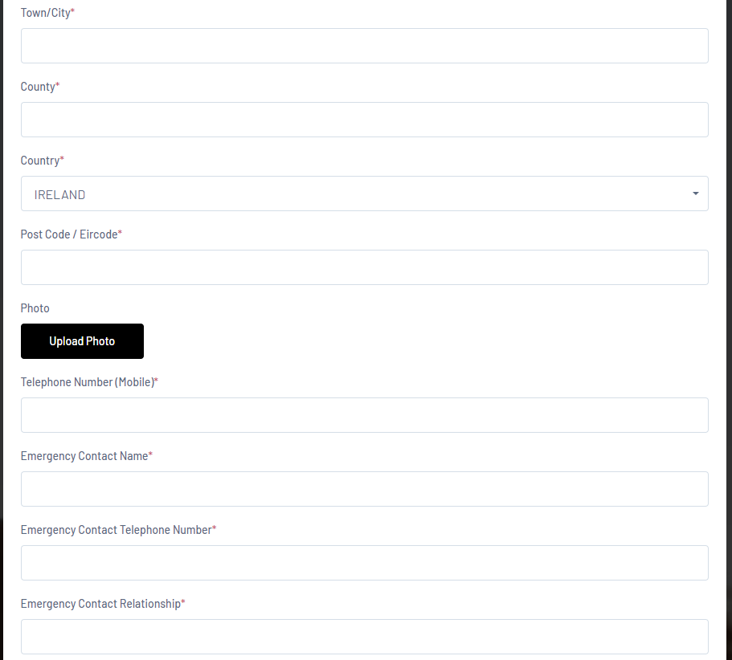
Fill out your emergency contact information. This is in case there is an accident and we can contact them for you.

Slide 11
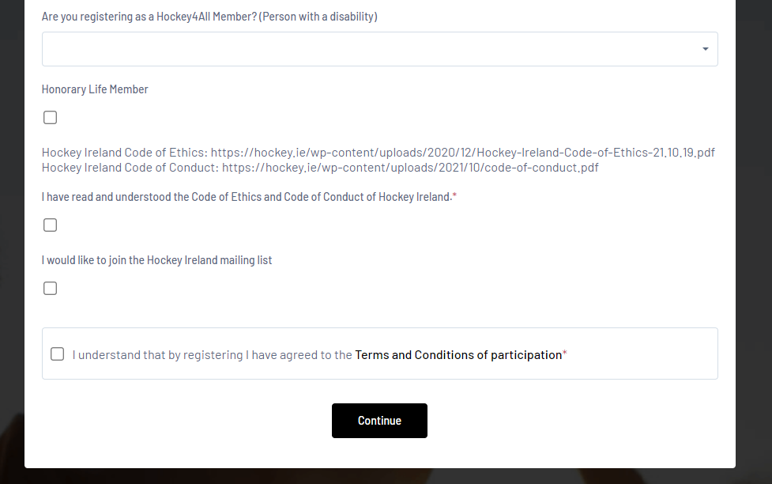
On this part, Hockey4All membership is for anyone with a disability. You don’t have to fill it out if it doesn’t apply to you.
If you say yes, another box will open to ask you what your disability is.
Copy and paste the links for Code of Ethics and Code of Conduct to view and read. The tick read and understood. Do the same for the last one, for Terms and Conditions. Tick on the box if you want to be on the mailing list.
Click on Continue.

Slide 12
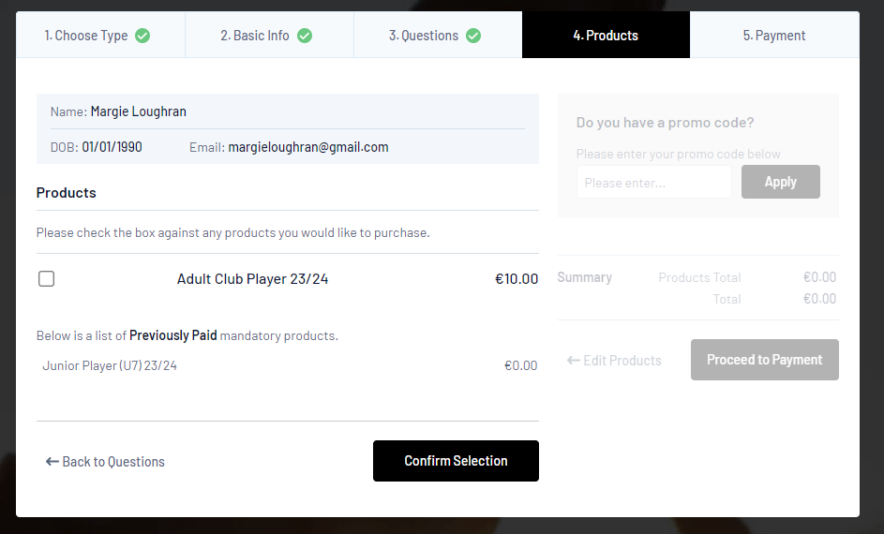
On this page, tick the product you are registering for and click Confirm Selection.

Slide 13
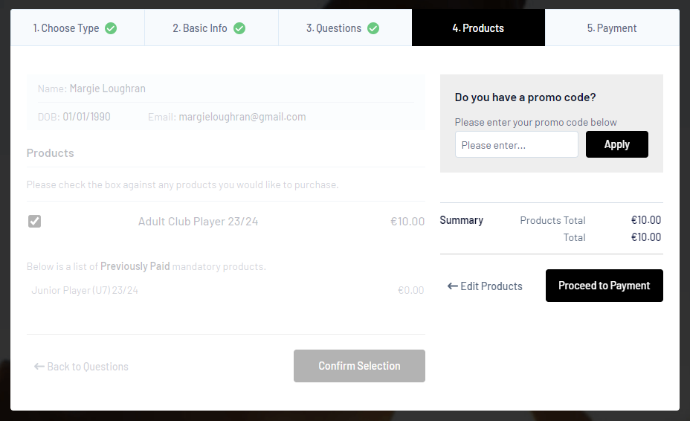
Click on Proceed to Payment on this page.

Slide 14
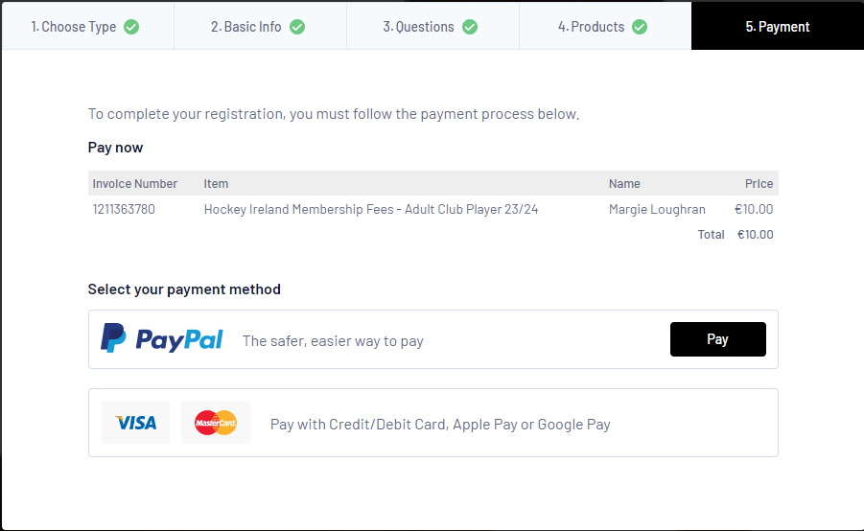
On the next page you will get a summary of what you are paying for and click on either PayPal or Card to make payment.
Once you pay, you will get a receipt from GameDay.
That’s it. You will now be registered.

