Slide 1
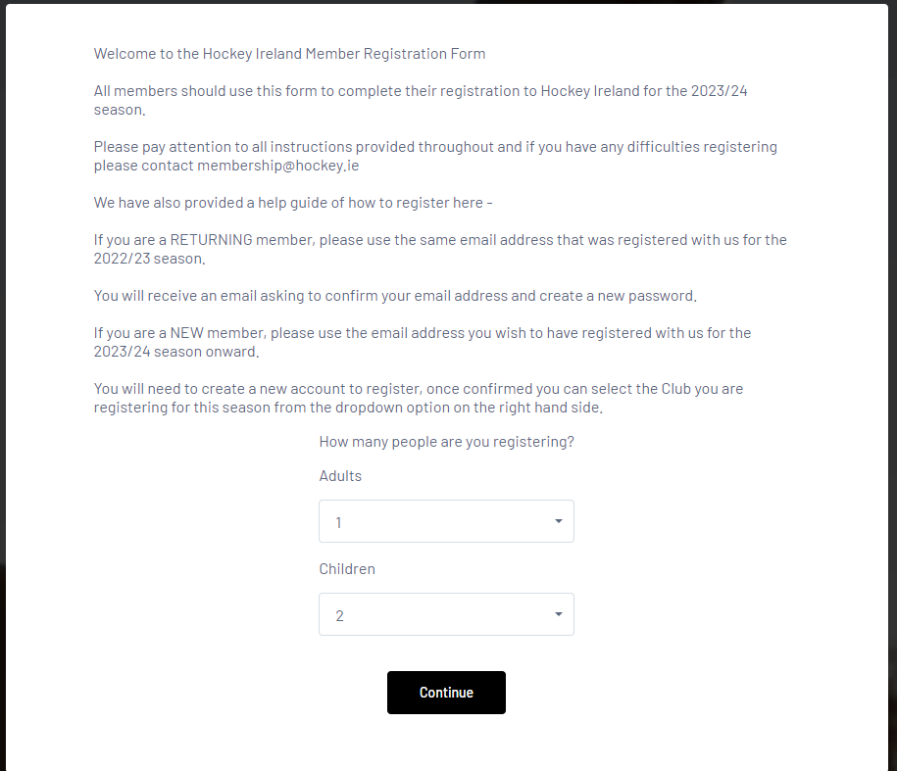
This presentation will show you how to register more than one member and walk you through the steps
Choose how many members you want to register.

Slide 2
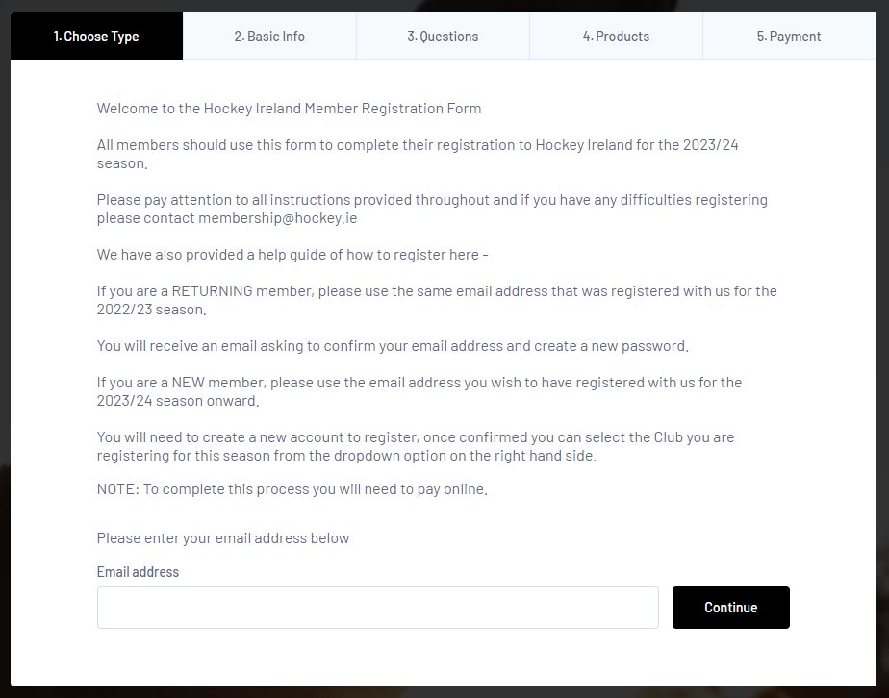
Sign in with the email address you registered with last season. If you forget what it was, please email membership@hockey.ie

Slide 3
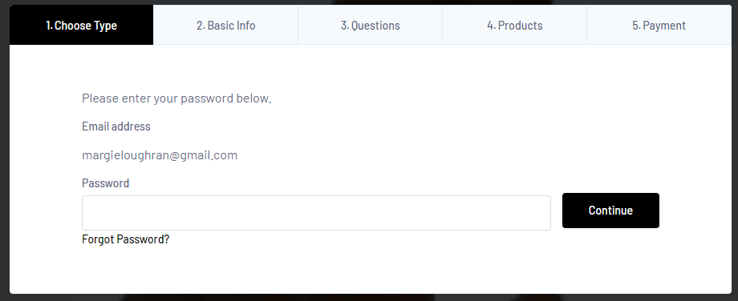
Then insert your password. If you forgot what it was, click on Forgot Password and you will receive an email to reset it. Then log in again.
If you do not receive an email within a few minutes, please check your spam folder and if not there, please contact membership@hockey.ie

Slide 4
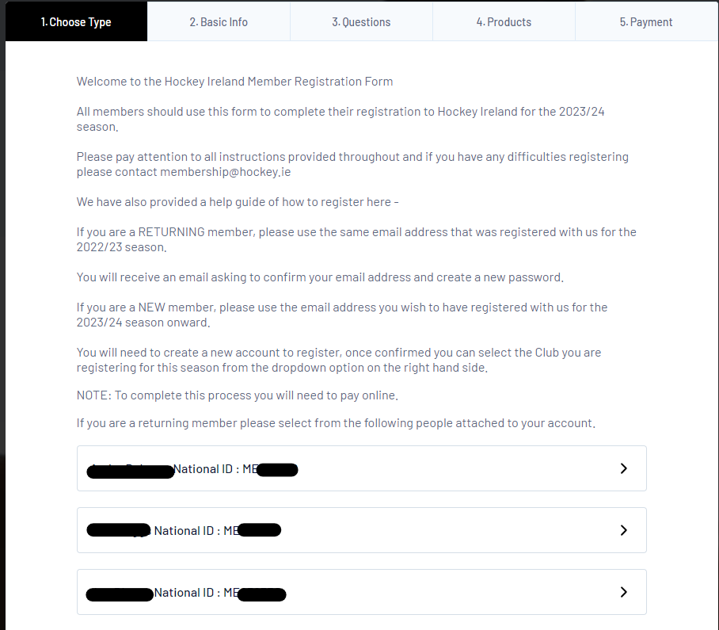
Once you log in, you will see the members associated with your email address you logged in with. If you don’t see everyone, it is possible you used another email address to register them with. Email membership@hockey.ie to enquire and we can change the email address for you.
Click on the first member’s ME number to register them.

Slide 5
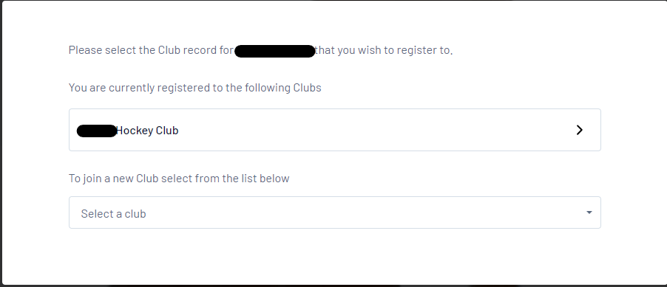
When you click on the first ME number you will see the club they are with and CLICK on that Club.
Do not click on Select a Club. You will get an error with an orange box saying you are already registered.

Slide 6
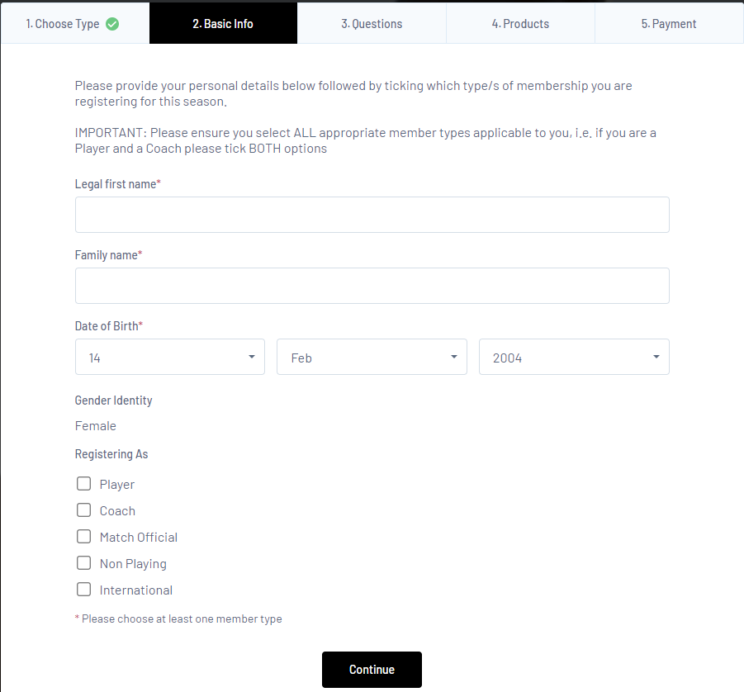
Fill out this part with first and last name, dob and what you are registering as. Then click Continue

Slide 7
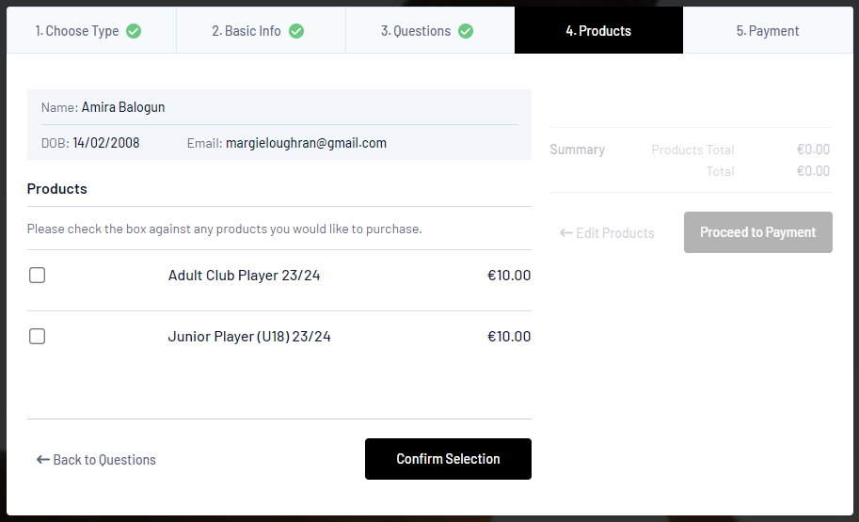
Fill out the rest of the form with the information required. Anything with a red asterix is a required field. Then hit Continue.
You will then get the following screen to choose what membership product you are purchasing for this member. Once you select, click on Confirm Selection

Slide 8
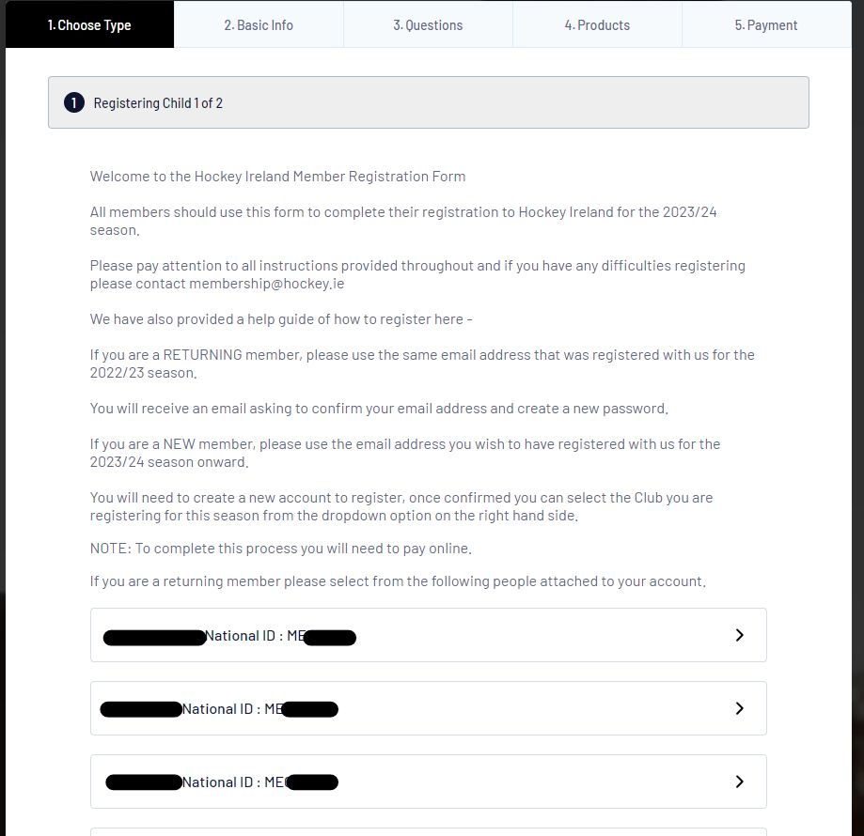
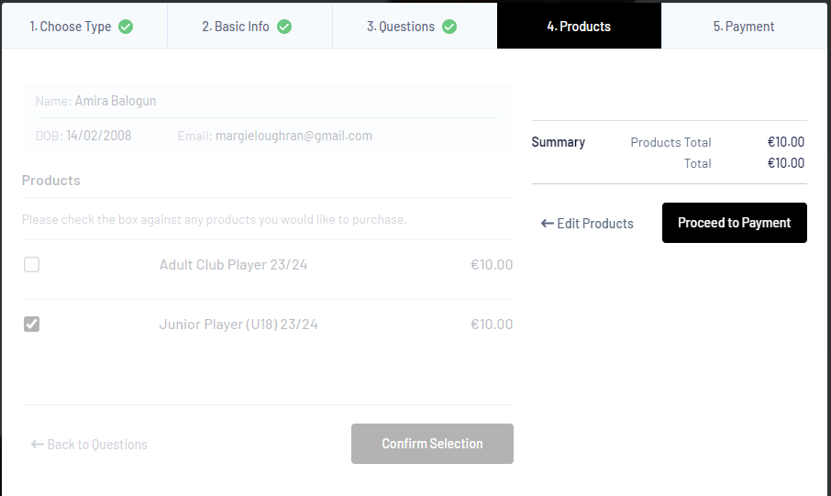
Once you click on Confirm Selection, click on Proceed to Payment and this will bring you to the page to choose the next person you are registering.
Then click on the next member to register and so on until you have filled out all information for all members.

Slide 9
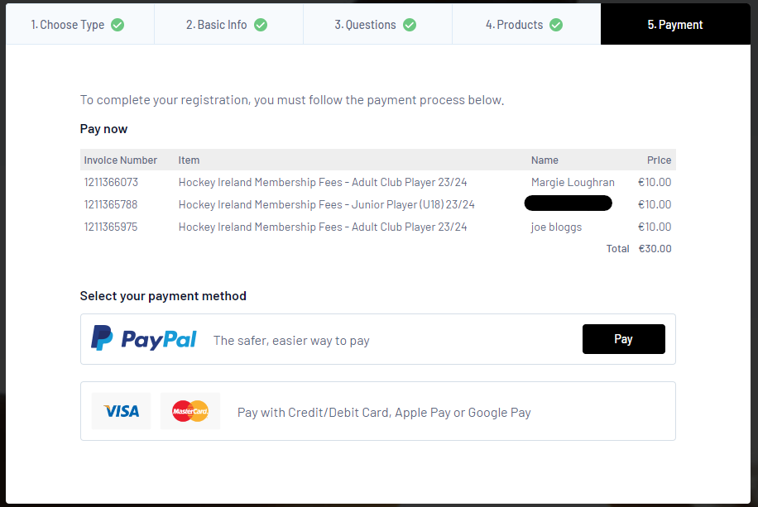
Once you have completed all registrations, you will come to a page with your total and you can then pay by PayPal or by card.
Once done, you will get a receipt from GameDay to say you have paid.

