Slide 1
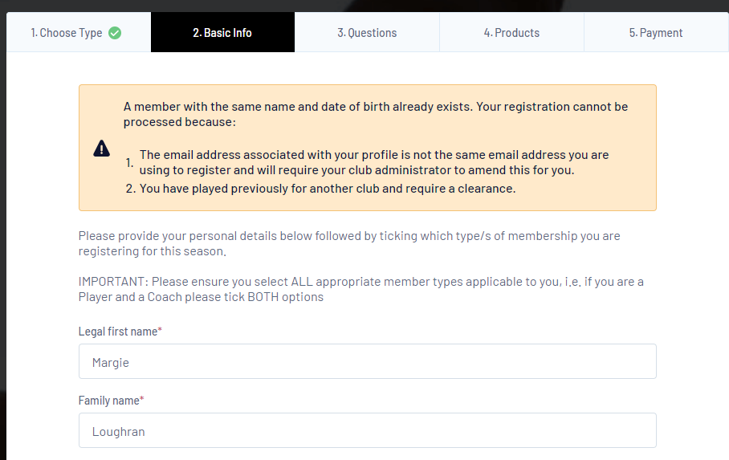
If you get this error, it means you have clicked on new club and not the club you are registered with. Please go back and click on the Club you are registered with.
Even if you are transferring, you need to register with the club you are transferring from. Once your transfer has gone through, your membership will move to the new club.

