Slide 1


Slide 2
Sponsorship News
EY have come on board for another season for the EYHL and the EYHL Division 2
On the back of this, we can confirm that a travel contribution will be available to every club this season
 The umpiring costs will continue to be paid centrally and not charged onwards to clubs
The IHL will continue to be known as EYHL and the EY Hockey Champions Trophy for the finals weekend
The IHL2 will continue to be known as EYHL Division 2 and the EYHL Division 2 Play-off Finals

Slide 3
Promoting the EYHL and Hockey
Hockey in Ireland at its highest point, we need you to promote Hockey and EYHL at every opportunity!
Clubs need to play their part in promoting the EYHL
  Think about all aspect of presentation of the match – not just a fixture!
  Match program and meeting minimum requirements for game presentation
  Social Media, Twitter; providing content, photos and video clips
  Getting results in on time and out on social media to minimum standard
  Your club info on the HI website needs to be up to date!
  EY - Shirt logo, ground signage – portable, so can be erected for each game
PR person is key – need to think PR at every opportunity
  Every aspect of the game – HP players, transfers, injury, etc. All information is
news – get it out there!! On every channel
  Immediacy of information and video content is king
  Local and national coverage
We all need to play our part to promote hockey

Slide 4
Twitter
Considered to be a public forum
1.4 million people on Twitter in Ireland
68% of Irish Enterprises use social media – prospective sponsors
92% of Irish Journalists use Twitter every day
#EYHL
  The channel to get info on the final result and info on each game as it
progresses – this is a HOST responsibility
  Minimum 4 tweets per game, to cover pertinent press requirements
  Content must follow standard outlined in Regulations

Slide 5
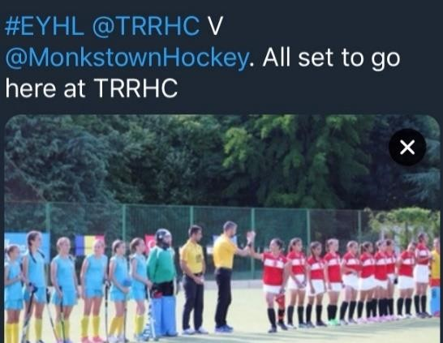
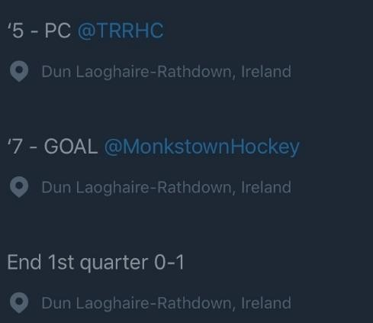
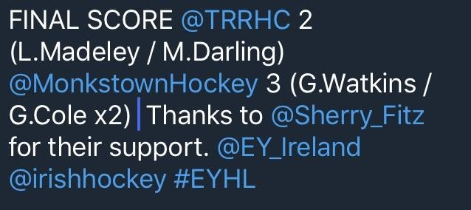
What should you do ?
Use your Club twitter handle NOT your personal account
A Twitter ‘Thread’ is preferred
Even better a post match VIDEO interview - 30 seconds with player or coach
Final score and scorers.
Both teams, no nicknames
Tag your sponsors and EY and Hockey Ireland
Tag journalists
Name competition
Tag both teams
Use Images
Use video
Add actions / cards, with the time
Use videos and images
Add end Q score

Slide 6
Twitter Handles – EYHL Women
Pegasus | @pegasushockey
UCD | @UCDLadiesHockey
Muckross | @MuckrossHC
Catholic Institute | @InstaLadies
Railway Union | @RailwayUnionHC
Old Alex | @OldAlexHC
Pembroke Wanderers | @PWHC
Cork Harlequins | @Cork_Harlequins
Loreto | @LoretoHC
Belfast Harlequins | @BelfastQuinsLHC
EY | @EY_Ireland
Hockey Ireland | @irishhockey
Stephen Findlater | @hookhockey
Nigel Ringland | @nigelringland
John Flack | @Flackeroos

Slide 7
Twitter Handles – EYHLD2 Women
UCC | @UCCLadiesHockey
Corinthians | @CorinthiansHock
Trinity College | @DULHC
Greenfields | @GreenfieldsHC
Queens University | @QUBHC
Cork Church of Ireland | @CorkCofI
Lurgan | @Lurganladies_hc
Ards | @ards_lhc
NUIG | @NUIG_L_Hockey
Monkstown | @MonkstownHockey
EY | @EY_Ireland
Hockey Ireland | @irishhockey
Stephen Findlater | @hookhockey
Nigel Ringland | @nigelringland
John Flack | @Flackeroos

Slide 8
Twitter Handles – EYHL Men
Monkstown | @MonkstownHockey
Annadale | @annadalehc
Three Rock Rovers | @TRRHC
Banbridge | @banbridgehc
Pembroke Wanderers | @PWHC
Lisnagarvery | @lisnagarveyhc
YMCA | @YMCAHC
UCD | @UCDMHC
Glenanne | @Glenannesc
Corinthian | @CorinthiansHock
EY | @EY_Ireland
Hockey Ireland | @irishhockey
Stephen Findlater | @hookhockey
Nigel Ringland | @nigelringland
John Flack | @Flackeroos

Slide 9
Twitter Handles – EYHLD2 Men
Railway Union | @RailwayUnionHC
Cork Church of Ireland | @CorkCofI
Avoca | @avocahc
Clontarf | @Clontarfhc
Cork Harlequins | @Cork_harlequins
Kilkeel | @KilkeelHC
Cookstown | @CookstownHockey
Instonians | @instonianshc
EY | @EY_Ireland
Hockey Ireland | @irishhockey
Stephen Findlater | @hookhockey
Nigel Ringland | @nigelringland
John Flack | @Flackeroos

Slide 10
Meeting the needs of media outlets
To ensure that hockey gets good coverage WE need to help them to help us!
Stephen Findlater (Hook, Irish Times, Irish Examiner), Nigel Ringland (BBC NI), John Flack (Belfast Telegraph), etc. All use twitter for it’s immediacy as tight deadlines, usually 6pm on Saturday
EYHL Twitter regulations came from the hockey media

Slide 11
Happy to help!
Marketing and Communications Manager
  Emma Porter
    Emma.porter@hockey.ie

Slide 12
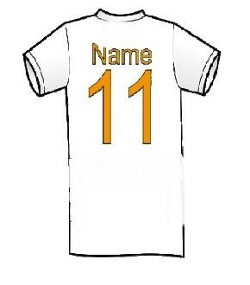
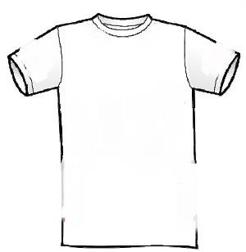


EY Promotion - Shirt Logo
Make sure all your team kit is correct!
Now applicable for all EYHL and EYHL Division 2 Teams
Get in touch with Emma if some missing logo’s, kit change, new club
Back of shirt under player number or shirt sleeve (two sizes available)
Detailed application instructions provided
· Fine will be applied if missing!

Slide 13
Best of luck this season!

